Slide 1
Embedded Multicores
Example of Freescale solutions
Miodrag Bolic
ELG7187 Topics in Computers:
Multiprocessor Systems on Chip

Slide 2
Outline
An Overview
Hardware Perspective
Software perspective
Example of Freescale QorIQ

Slide 3
Single processor disadvantages
Increasing frequency
  doubling the frequency causes a fourfold increase in power consumption.
  higher frequencies need increased voltage
power = capacitance × voltage² × frequency
  Increase number of pipeline stages
    Overhead – forwarding, registers, ...
    Increased latency
  Memory wall
  Managing hot-spots (no need for cooling when <7W)

Slide 4
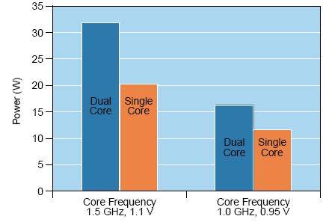
Power consumption – multicore MPC8641

Slide 5
Types of multicores
Type of the cores
  Homegeneuos
  Heterogeneous
Memory system
  Shared memory
  Distributed memory
  Hybrid
Number of cores
  Manycore >10 cores
    Challenges: redesign applications to efficiently use all the cores

Slide 6
Type of paralelism
Bit-level
Instruction level
Data parallelism
  Cores are able to work on the data at the same time
Task parallelism
  Thread – a flow of instructions that run on a CPU independent of other flows

Slide 7
System and software design
Asymmetric processing (AMP)
  An approach to multicore design in which cores operate independently and perform dedicated tasks.
  Example: each core specialized for a specific step in a multi-step process.
Symmetric processing (SMP)
  An approach to multicore design in which all cores share the same memory, operating systems, and other resources
  OS distributes the work
  Threads can be assigned to any core at any time
Combination
  AMP used as software accelerators – run RTOS
  SMP for general purpose and control oriented services – run Linux

Slide 8
Multiple operating systems
Hypervisor
  System-level software that allows multiple operating systems to access common peripherals and memory resources and provides a communication mechanism among the cores.
Virtual machines
Simulators are necessary – virtual platforms
  Simulated computing environment used to develop and test software independently of hardware availability
  Analysis of hardware designs

Slide 9
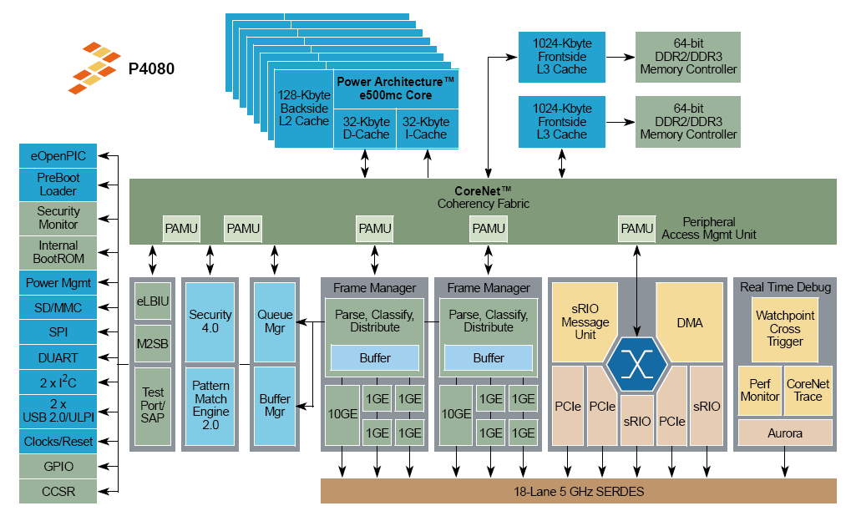
QorIQ P4080 Block Diagram

Slide 10
Features
Eight cores – superscalar e500mc
  five execution units, the branch, floating-point, load/store, and two integer units, allow out-of-order execution
Multi-core with tri-level cache hierarchy
Power savings
  Wait instruction
    Halts until the interrupt
    instruction fetches and execution stops
  separate power rails with different voltages, including complete shutdown
  multiple PLLs to allow some cores to run at lower frequency

Slide 11
System level
Interrupts
  Support for prioritizing them
  Support for assigning interrupts to different cores
MMU per each core
  Protect applications from interfering with each other
PAMU (Peripheral access management unit)
  Peripherals such as DMA ca corrupt memory
  Configured to map memory and provide limited access to peripherals

Slide 12
Interconnection network
Buses
  More cores => longer buses => slower buses
  More cores => less bandwidth per core
Switch fabric
  CoreNet is an on-chip, high efficiency, high performance multiprocessor interconnect
  Point-to-point interconnect
  Independent address and data paths
  Pipelined address bus, split transactions
  Supports cache coherence
  Supports software semaphores

Slide 13
Memory
Private I,D-L1 and L2 caches
Alternate configurations
  where the core is configured as a software accelerator, the L1 and L2 caches can accommodate all code with plenty of room for data.
  Cache can be configured as SRAM and address it as normal, store variables

Slide 14
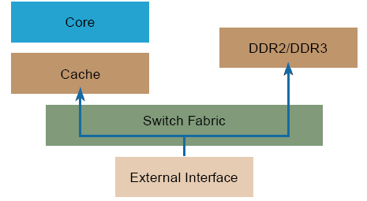
Cache stashing
Data received from the interfaces are placed in memory and the core is then informed through an interrupt.
Stashing - the data is placed in L1/L2 cache at the same time as it is sent to memory

Slide 15
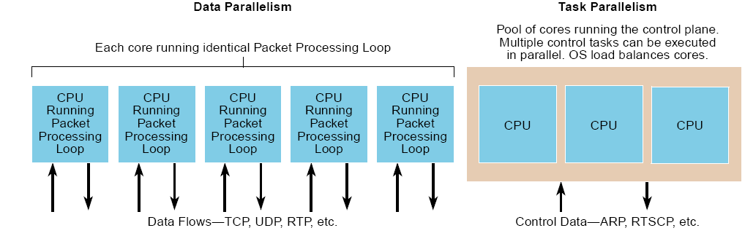
Example - router
Data plane
  handling packets for the data flow
Control plane
  handle control and configuration tasks

Slide 16
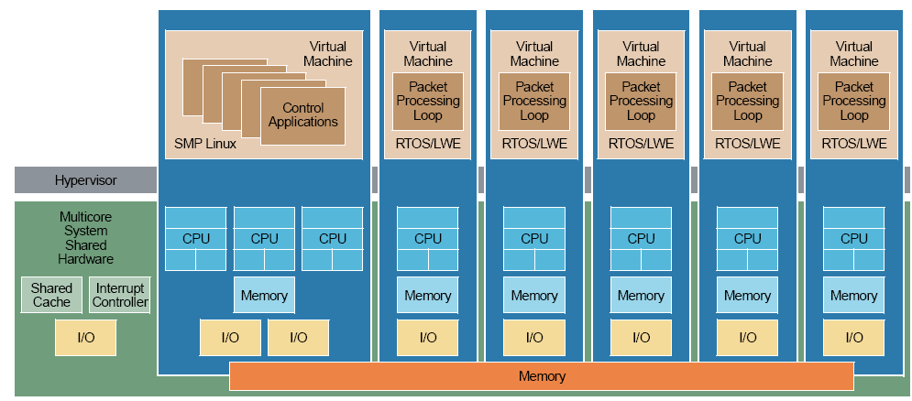
Network routing application

Slide 17
Task and process mapping
Processor affinity
  Modification of the native central queue scheduling algorithm. Each queued task has a tag indicating its preferred/kin processor. At allocation time, each task is allocated to its kin processor in preference to others.
Soft (or natural) affinity
  The tendency of a scheduler to keep processes on the same CPU as long as possible
Hard affinity
  Provided by a system call. Processes must adhere to a specified hard affinity. A processor bound to a particular CPU can run only on that CPU.
  Data plane of the router – requires low latency and predictability

Slide 18
Run to completion
Interrupt problems
  Large number of them
  Overhead
Assign interrupts to other cores
Perform task to the end without interruption
Bare metal – application software running directly on hardware

Slide 19
Symmetric multiprocessing
Symmetric multiprocessing (SMP) is a system with multiple processors or a device with multiple integrated cores in which all computational units share the same memory
Scalability problem – 8 to 16 cores
Load-balancing: ensuring that the workload is evenly distributed across the system for maximum overall performance

Slide 20
Parallel application design
Master/worker
  One master thread executes the code in sequence until it reaches an area that can be parallelized. It then triggers a number of worker threads to perform the computational intensive work.
Peer
  Master is also functioning as a worker
Pipelined – stream based

Slide 21
Posix threads
Pthreads – a thread API for portable operating systems
60 functions divided in 3 classes
  Creating and terminating threads
  Mutex locks
  Conditional variables for communication among threads
GCC compiler supports PThreads

Slide 22
OpenMP
An API that supports multiplatform shared memory multiprocessing programming in C/C++ and Fortran on many architectures.
Mainly targets microparallelization
Support for incremental programming

Slide 23
Synchronization
Locks
  provide mutual exclusion
  Ensure only one thread is in critical section at a time
Semaphores have two purposes
  Mutex:
    Ensure threads don’t access critical section at same time
  Scheduling constraints:
    Ensure threads execute in specific order
Barriers

Slide 24
Problems with multithreaded software
Race conditions
  Multiple threads access the same resource at the same time generating an incorrect result.
Deadlocks
  A deadlock situation occurs when two threads need multiple resources to complete an operation, but each secures only a portion of them. This can lead to both threads waiting for each other to free up a resource. A time-out or lock sequence prevents deadlocks.
Livelocks
  A livelock occurs when a deadlock is detected by both threads; both back down; and then both try again at the same time, triggering a loop of new deadlocks.
Priority inversion
  This occurs when a high-priority thread waits for a resource that is locked for a low-priority thread. A common solution to this is to temporarily raise the low-priority thread to the same level as the high-priority thread until the resource is freed.

